Slide 1
250k Medicines Usage, Side Effects and Substitutes

Slide 2
Purpose
Objective
To provide a comprehensive resource for drug information, supporting research, healthcare decisions, and drug safety.
Support pharmaceutical research on compositions and therapeutic uses.
Inform healthcare professionals on alternatives, side effects, and interactions.
Facilitate monitoring of adverse reactions and pharmacovigilance.

Slide 3
Details of Data
Drug Identifier and Manufacturer Details: A unique identifier for each drug, along with information on the manufacturing company and country of origin.
Product Categories: Categories like therapeutic class, action class, and chemical class, plus subcategories for detailed classifications.
User-Specific Columns: Include patient demographics, dosage frequency, and common side effects. You could add multiple columns for substitutes, uses, and known drug interactions.
Dataset Purpose: Like a real-world retail dataset, this layout would make it ideal for practicing EDA and visualizations, particularly for healthcare and pharmacovigilance analysis

Slide 4
Data Cleaning and Preprocessing
Steps to Follow:
Data Loading and Initial Exploration: Loaded the dataset and reviewed basic statistics and data structure.
Actions Taken: Displayed the first few rows, calculated summary statistics, and checked data types and non-null values.
Data Cleaning:
Identified and handled missing values.
Actions Taken: Checked for missing values in each column and filled them with 'Unknown' to prepare the data for analysis.

Slide 5
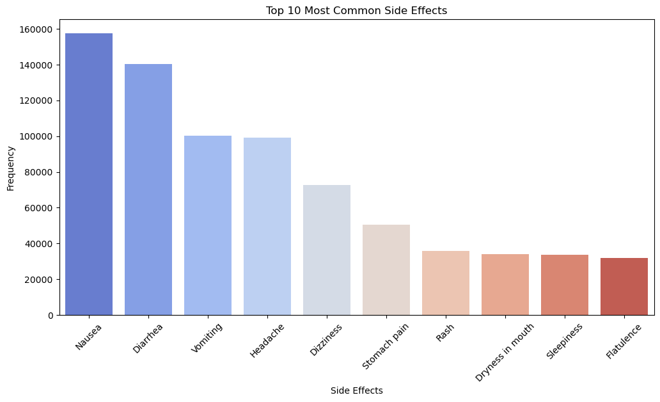
Visualization of the most common side effects

Slide 6
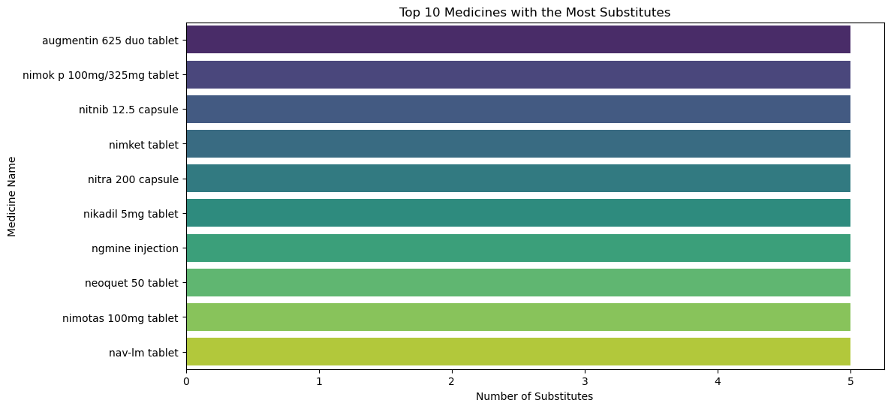
Visualization of the top medicines with the most substitutes
.

Slide 7
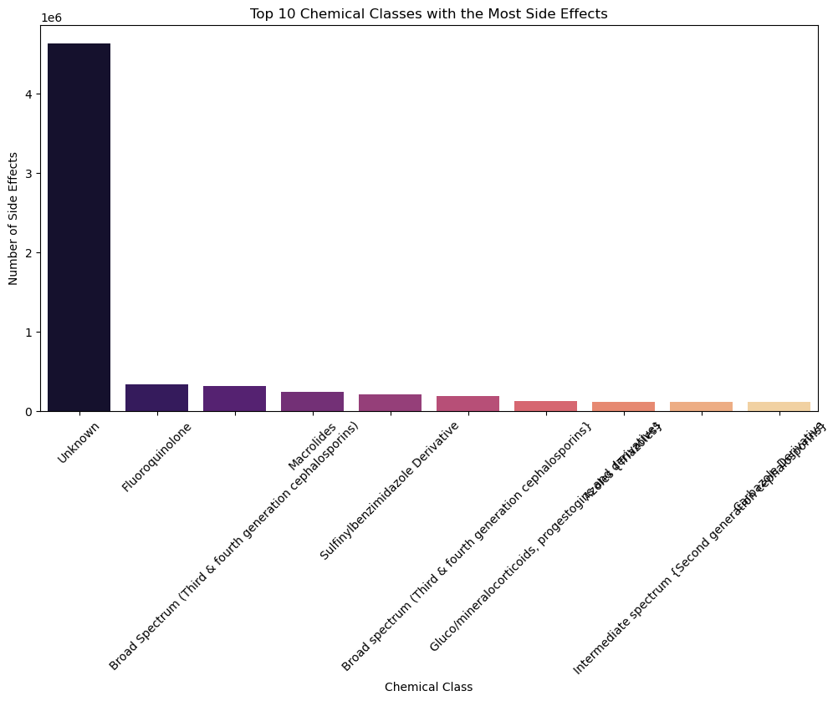
Visualization of side effects by Chemical Class

Slide 8
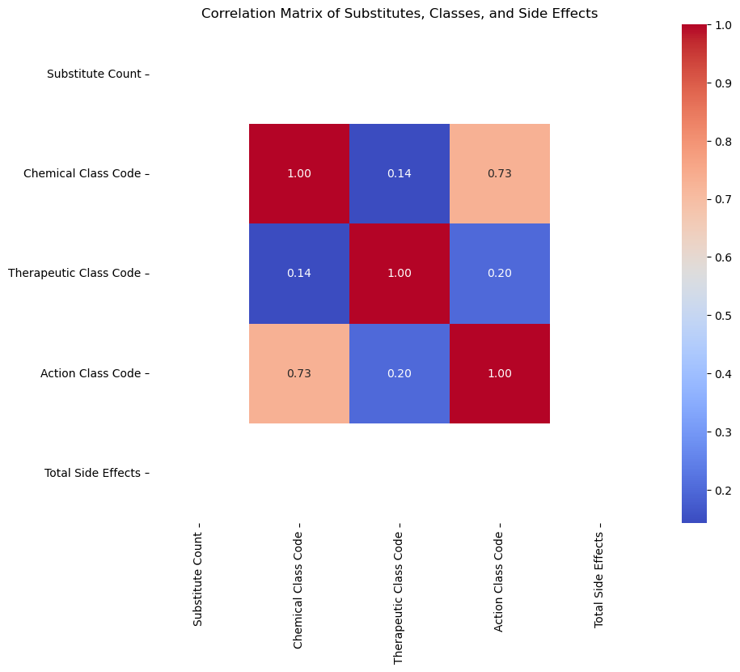
Correlation Analysis

Slide 9
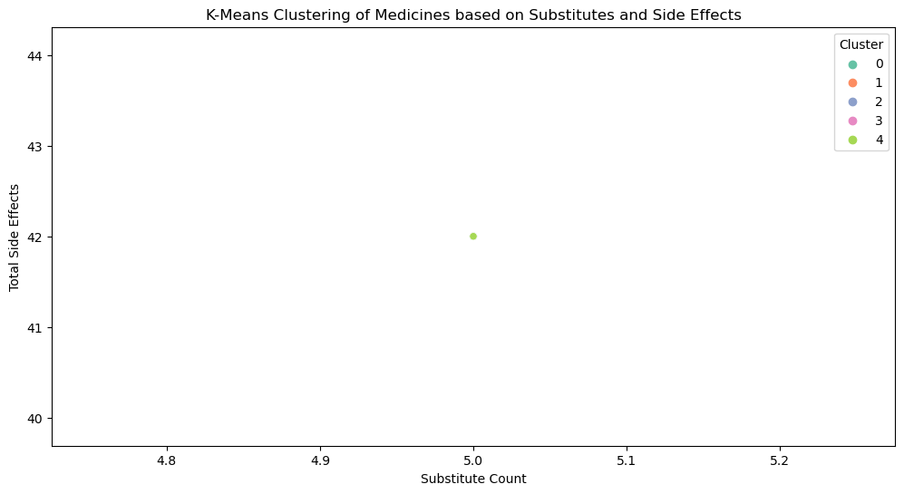
Clustering Analysis (Advanced)

Slide 10
Thank you

